Slide 1
Mapping Accountability Processes in Cambodia
Adam McBeth
Monash University – Oxfam Partnership

Slide 2
Project case studies
Communities where Oxfam Australia is working: Kratie, Stung Treng
Urban land development: Boeung Kak “Lake” (Phnom Penh)
Threatened by hydro dams: Lower Sesan

Slide 3
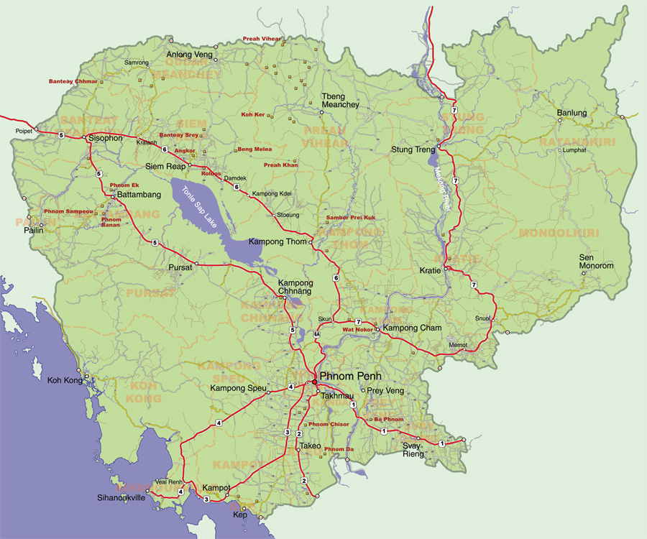

Slide 4
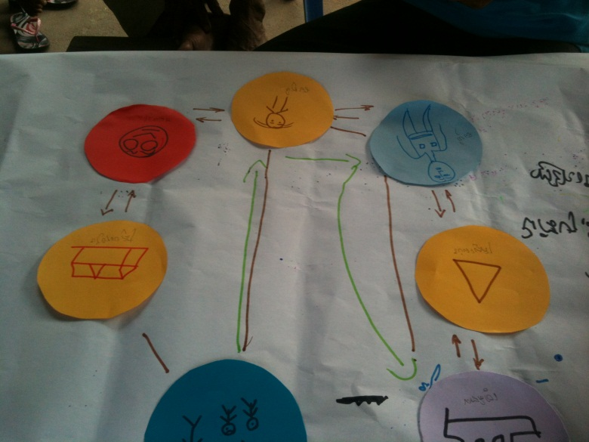
Perceptions of accountability
Community perceptions
External assumptions

Slide 5
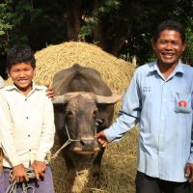
Oxfam’s Integrated Community Development model
Tripartite structure –
community groups
local government officers
Oxfam staff
Community-based committees, e.g. rice banks; buffalo banks; savings groups; community fisheries; village health support groups; women’s self-help groups; livestock associations

Slide 6
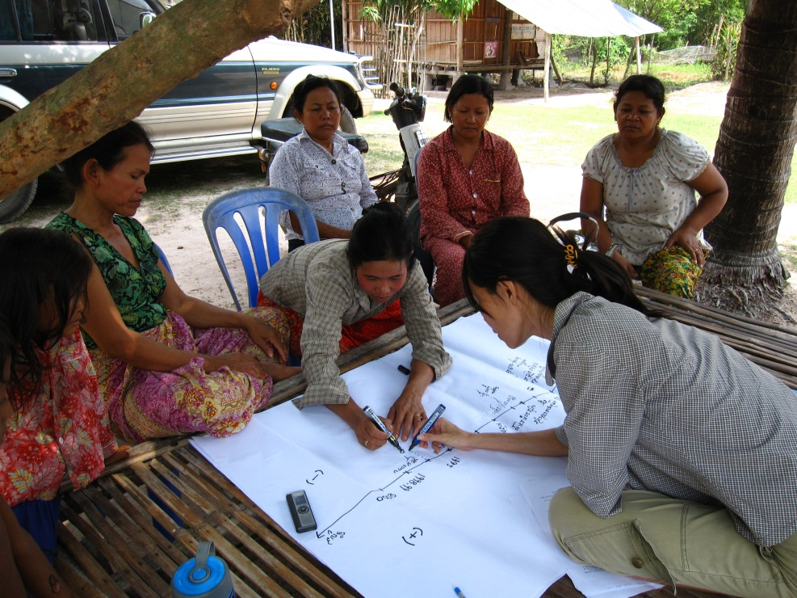
Identified concerns (external)
Planned hydroelectric dam and forced relocation
Land concessions encroaching on farm land
Road construction (+ and -)

Slide 7
Local accountability processes
Village chief the ‘correct’ process
Committee system impact
Committee members more willing to speak up, participate (especially women)
Info sharing between members & non-members seems limited
Government engagement
Little penetration beyond village / commune level (practical and conceptual)

Slide 8
NGO impact
Oxfam – ICD model
Urban communities – exposure to international NGOs; use formal/legal accountability processes
Sesan – working with various local NGOs with different philosophies towards resettlement

Slide 9
Objectives
Better understanding of community perceptions of accountability
Better engagement of those involved in project design and intermediaries (eg NGOs) with communities
Work with communities to bridge accountability gaps
Find effective mechanisms to achieve community goals

